Slide 1
How to identify pulsars？
上海市数据科学重点实验室
复旦大学计算机科学技术学院
Email:17210240244@fudan.edu.cn

Slide 2
Outline
Introduction
Finding Pulsars
Radio Frequency Interference
PRESTO and Finding Pulsars
Telling Real Pulsars from RFI

Slide 3
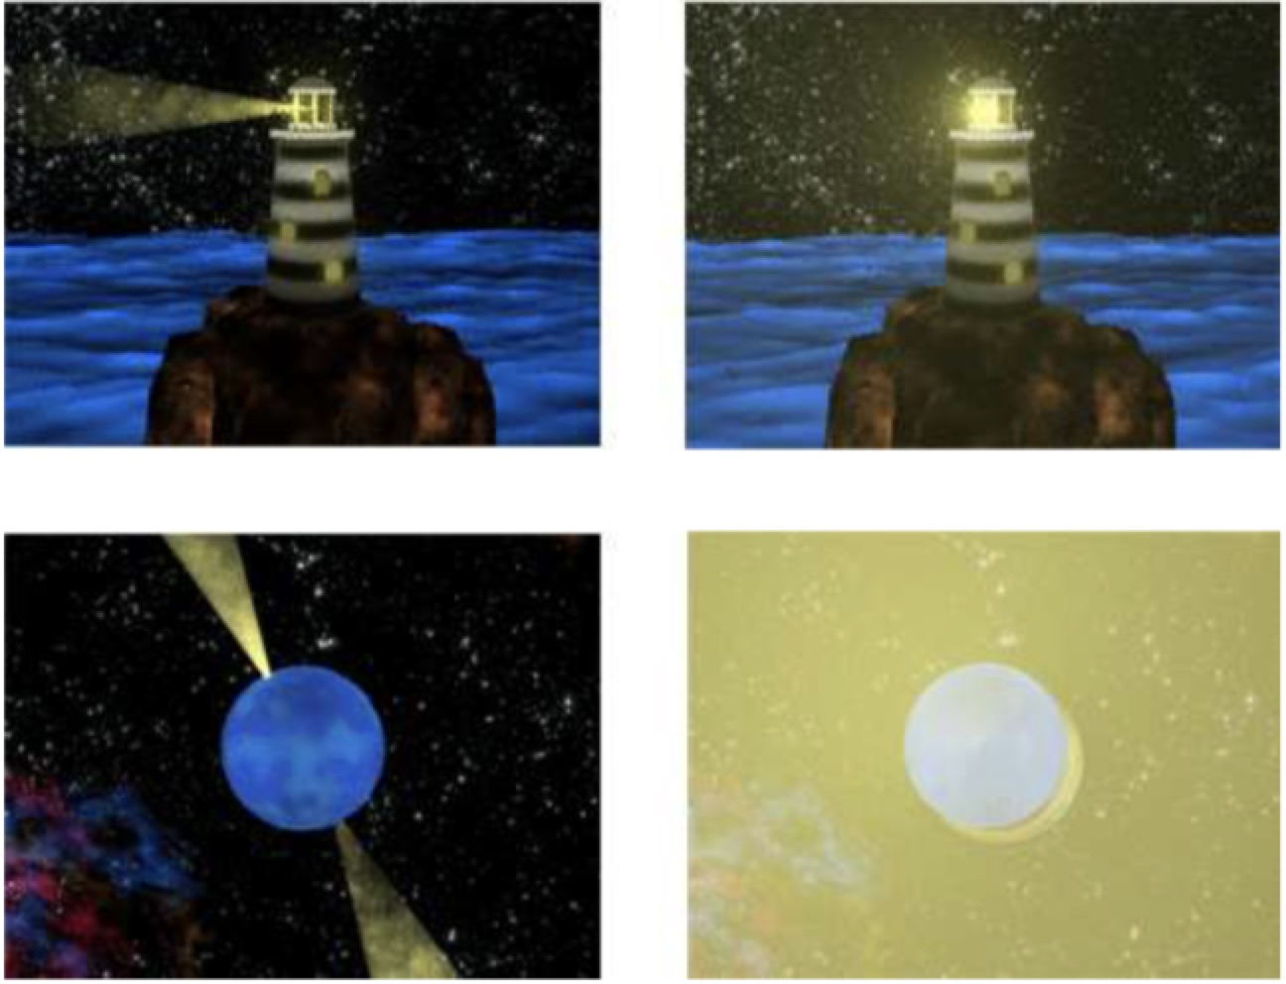
Introduction
1.Pulsars are a special class of neutron star

Slide 4
Introduction
1.Pulsars are a special class of neutron star

Slide 5
Radio Frequency Interference
we live in a world that is full of other sources of radio waves.
1.Your car radio
2. Satellite TV uses radio waves to send its information.
3. Cell phones and wireless Internet transmitters
…
There are cosmic sources of radio waves too, like our very own Sun.
RFI is especially problematic for pulsar searches because it can often look like a pulsar signal

Slide 6
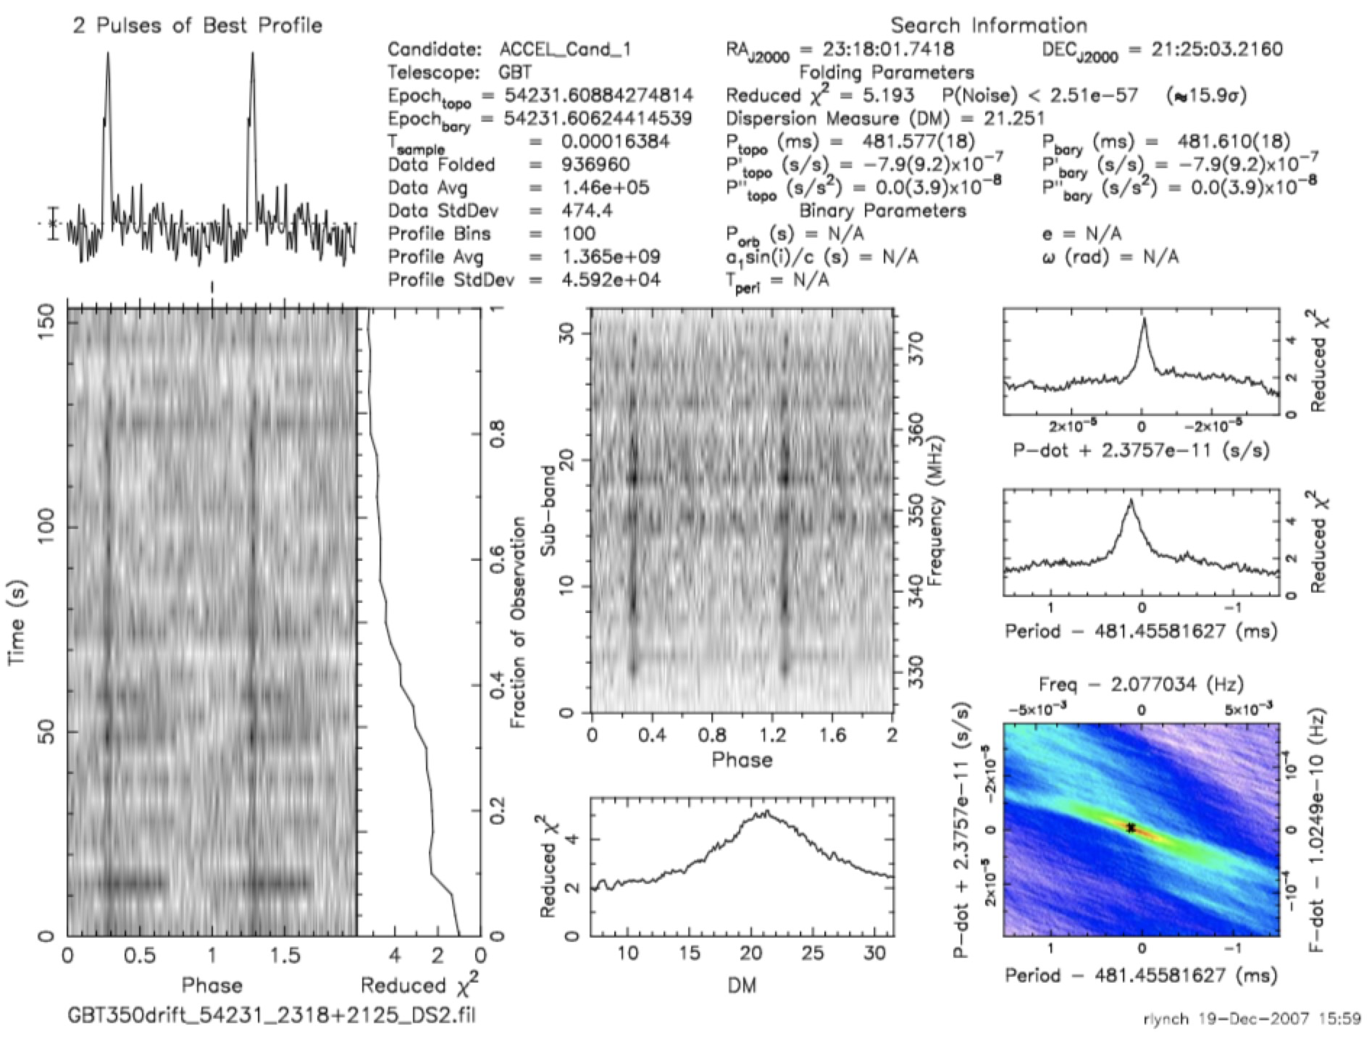
PRESTO and Finding Pulsars

Slide 7
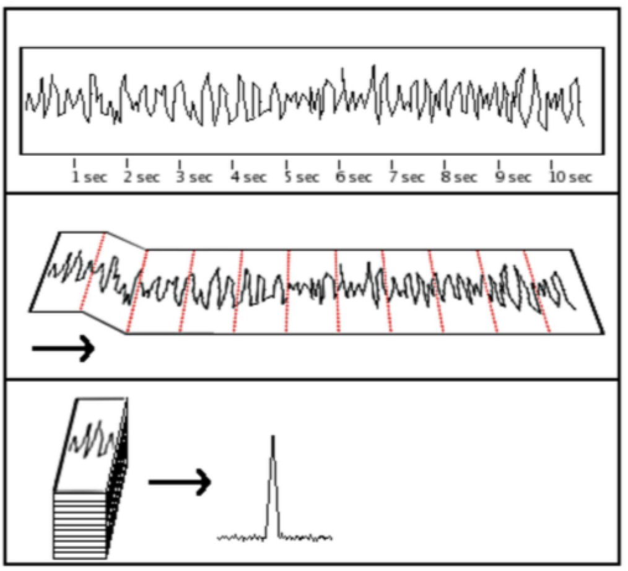
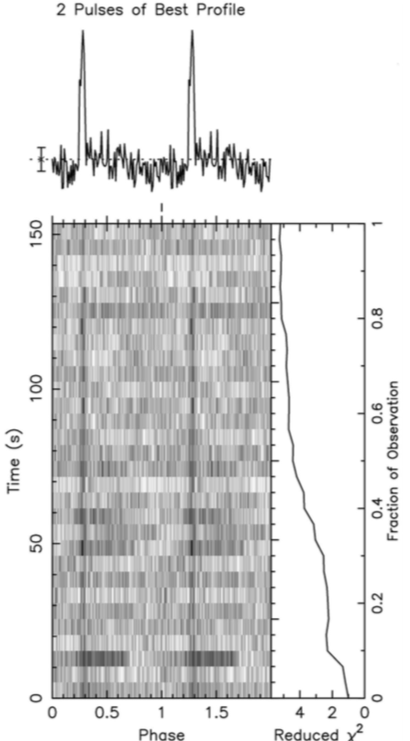
Finding Pulsars
1. the higher the mark is on the paper, the stronger the signal

Slide 8
The Time Domain and Pulse Profile

Slide 9
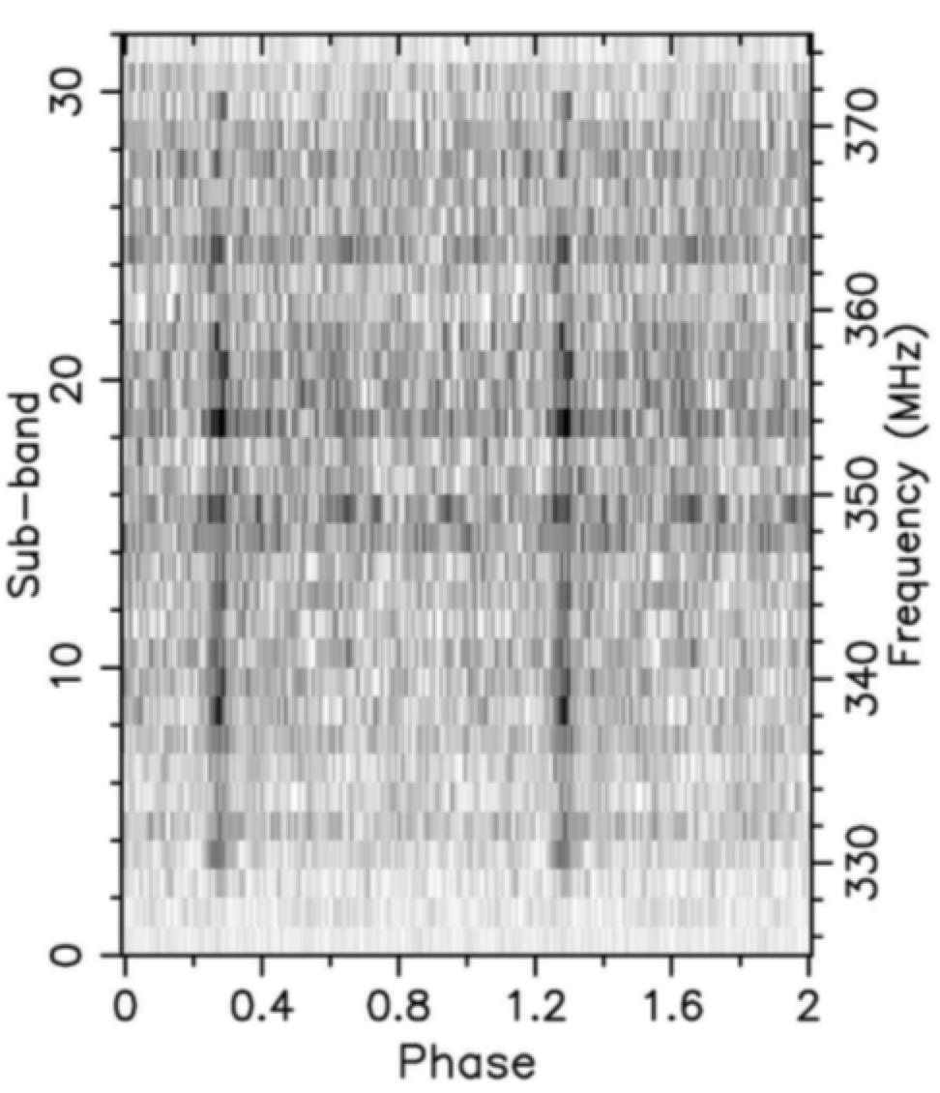
Frequency and Sub-bands

Slide 10
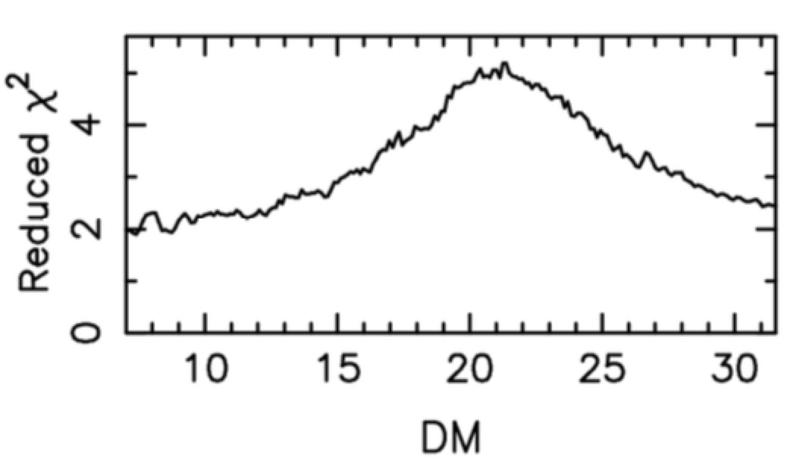
The Dispersion Measure
One of the things that we find in space are electrons.
These electrons disperse the pulsar’s signal (hence the name “dispersion measure”),
causing lower observing frequencies to arrive later than higher observing frequencies.
DM = 0？
DM大小表示色散程度

Slide 11
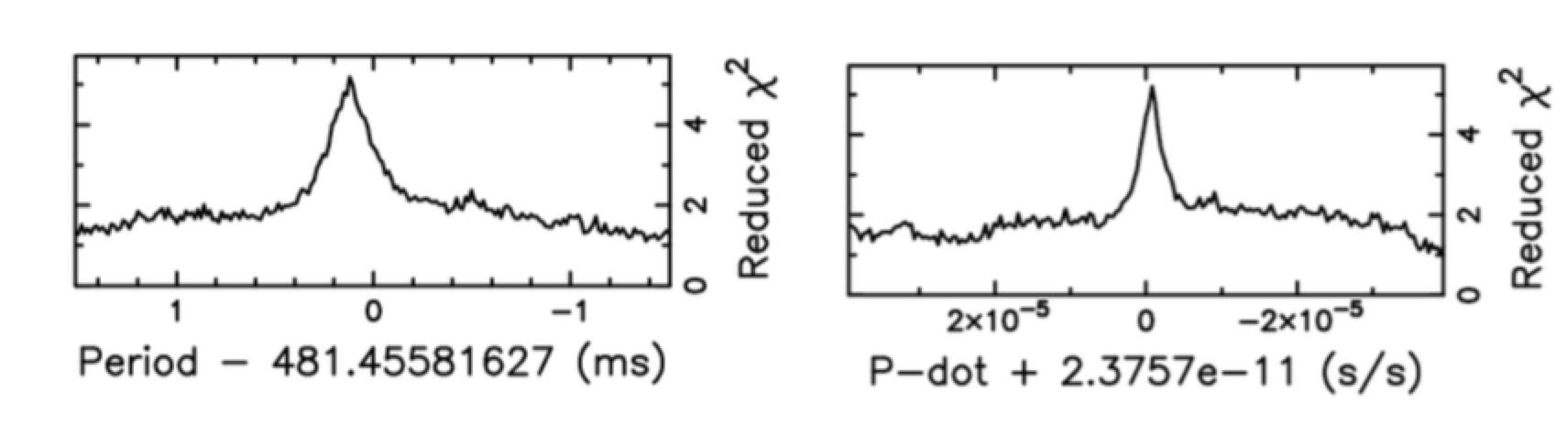
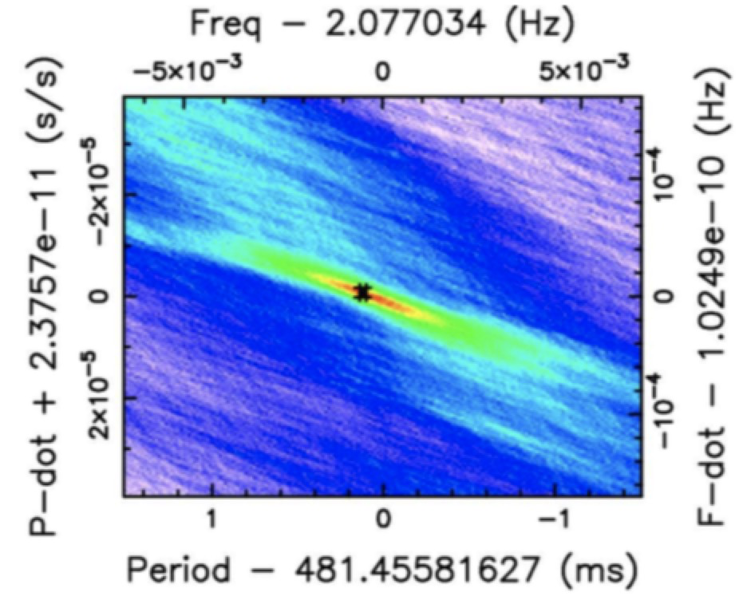
The Dispersion Measure

Slide 12
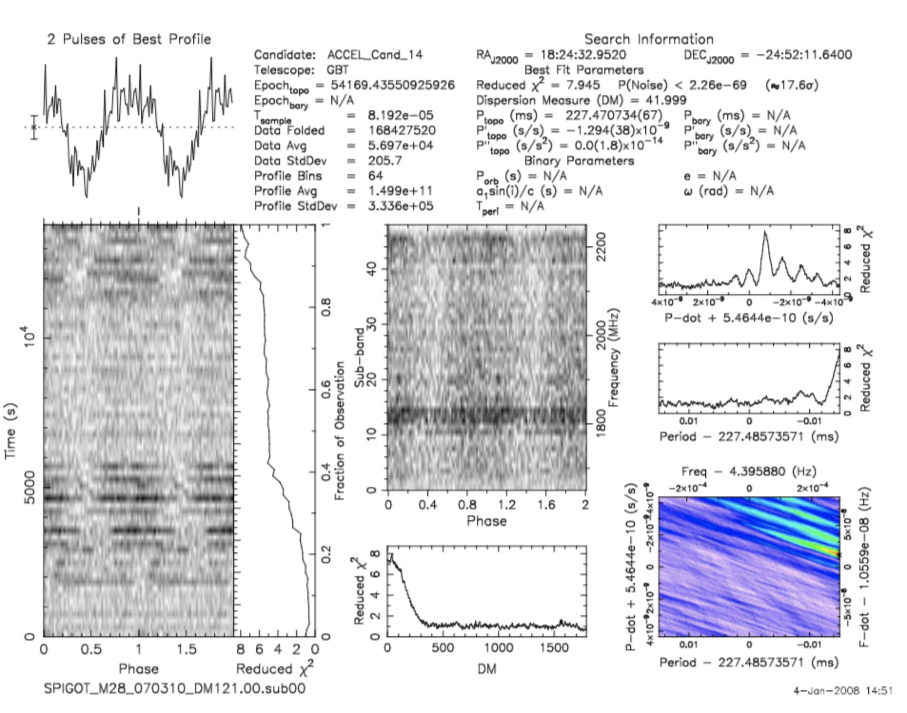
Telling Real Pulsars from RFI

Slide 13
Using the Time Domain Plot and Pulse Profile
1.The pulse profile should be a narrow peak,not a broad bump.
Exception: the beams of some pulsars can point at the Earth throughout most of the pulsar’s rotation,
so some pulsars have fairly broad beams. Also, some pulsars don’t have a single, narrow beam,
but instead have complicated beams with many different bright and dim patches.
This can cause the pulsar to have many peaks at different phases.
The lesson: don’t judge a pulsar candidate by its pulse profile alone!!
2. It is possible for a pulsar’s signal to drift in phase.
This will happen when the pulsar is highly accelerated, possibly due to a nearby companion star.
We call these binary systems
At first glance it seems to have a wave-like structure, but the signal abruptly jumps in phase.
This is something a real pulsar doesn’t do.

Slide 14
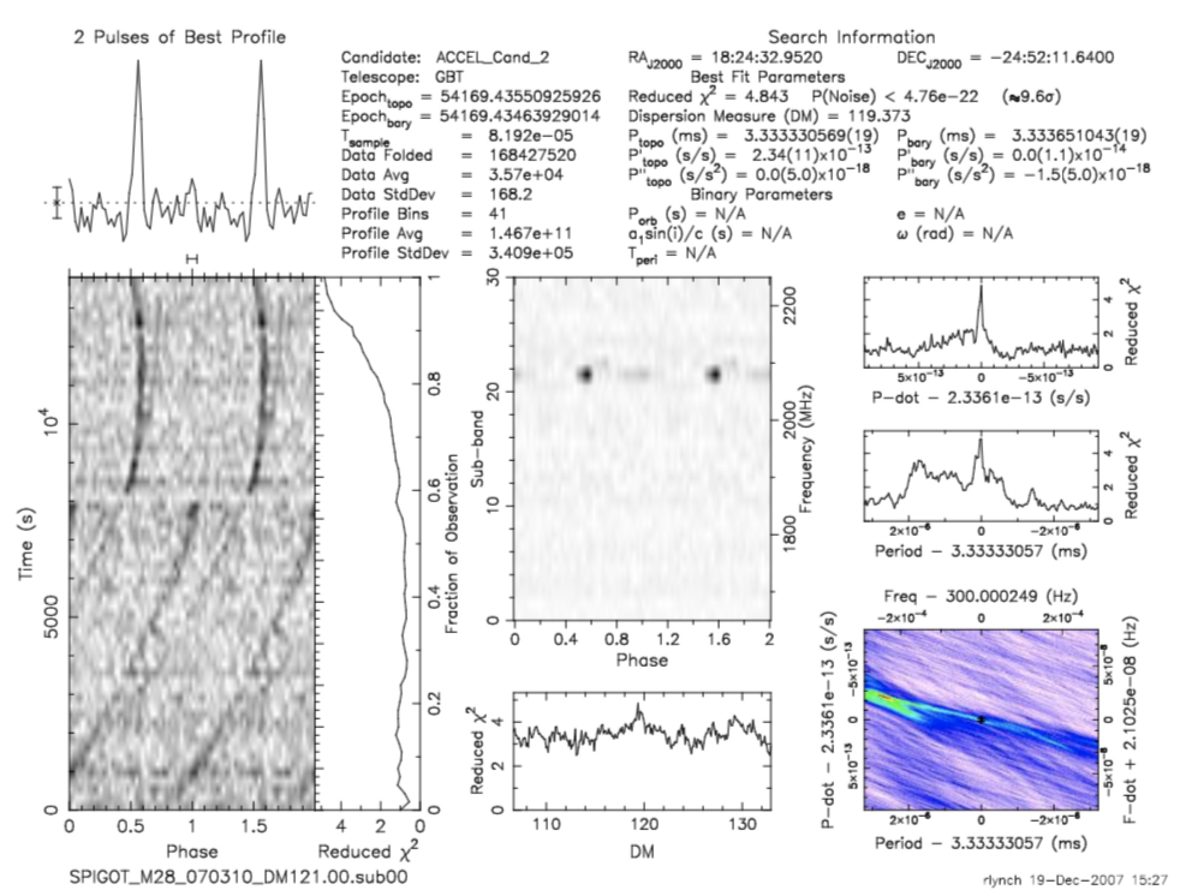
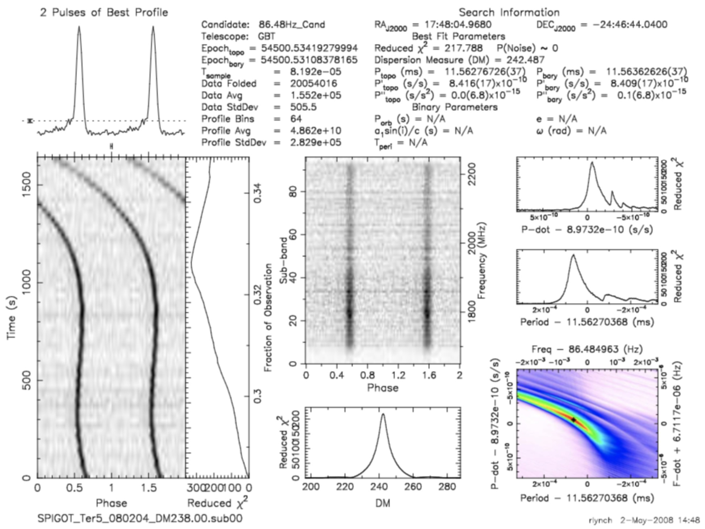
Using the Time Domain Plot and Pulse Profile

Slide 15
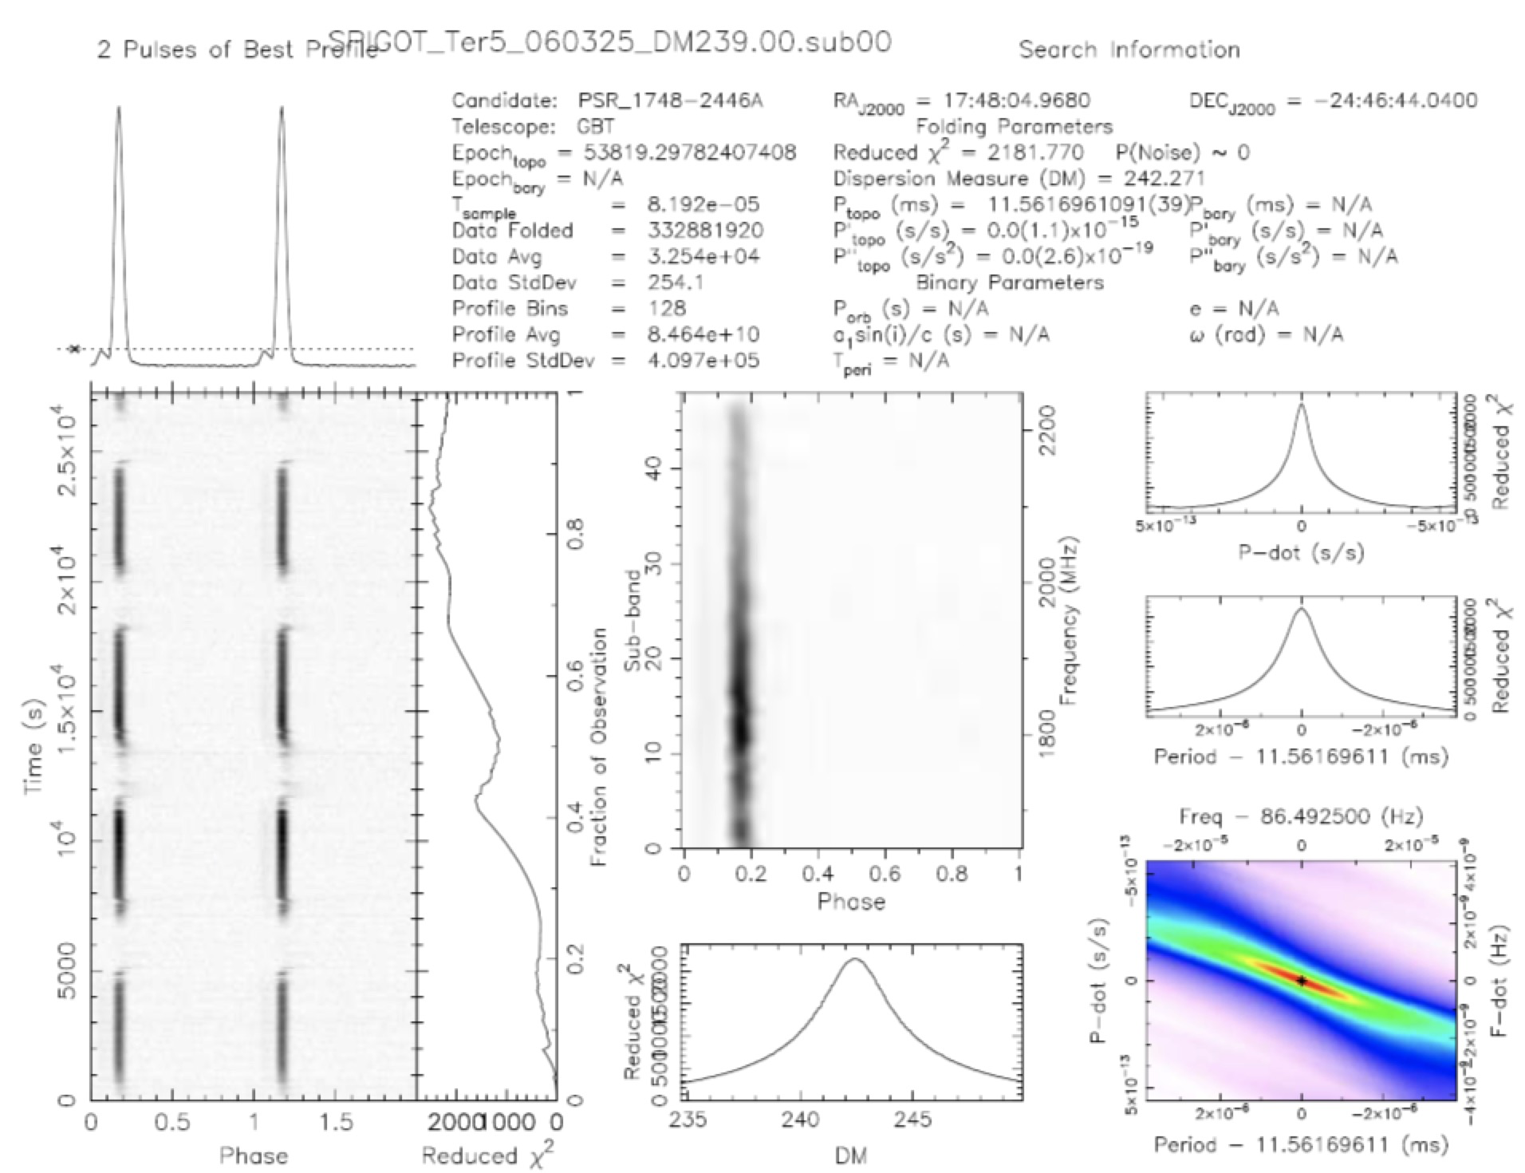
Transient Emission
1. Transient Emission
Sometimes, the source of RFI that is masquerading as a real pulsar is only turned on for some small fraction of our observation.
This may occur if the source of RFI (like a communications satellite) is only active for a brief period of time.
But there are important exceptions to this rule!.
Pulsar emission can actually turn off during an observation. (binary system)
So if you see transient emission, it could be a sign of RFI.
But it could also be a sign of an eclipsing system or
nulling pulsar.
To tell them apart, you will need to examine other
parts of the plot, such as the Frequency/Sub-bands
and the Dispersion Measure.

Slide 16
Broadband vs. Narrowband Signals
1.Narrowband signals
a given radio station only broadcasts its signal in a very narrow range of frequencies to avoid overlapping with other stations
2.Broadband emission
pulsars beam radiation at a wide range of frequencies,
Since pulsar emission is broadband, we will see power at all the observing frequencies.

Slide 17
The Dispersion Measure
One of the most useful ways of identifying RFI is to look at the DM curve. Recall that
any real pulsar signal must travel through space to reach us, and in doing so will certainly encounter some electrons.
On the other hand, a signal originating near the Earth will not encounter any electrons and will have a DM very nearly zero.
So if the DM curve peaks at zero, then you almost certainly have found RFI, not a real pulsar.

Slide 18
Summarizing the steps
1.Look at the pulse profile.
Is the signal sufficiently high above the noise level?
Is the profile free of strange signals that do not normally show up in real pulsars?
2.Look at the time series.
Is the signal persistent?
Does it occur at the same phase, or drift in phase in the way a binary pulsar would?
Are there obvious sources of RFI?
3.Look at the sub-bands.
Does the signal occur at a wide range of frequencies or is it narrowband?
4.Look at the DM curve.
Does it peak at a non-zero DM?
Is the DM well measured, or is there considerable uncertainty in the measurement?
5.Look at the period and frequency.
Are they round or “convenient” numbers, such as P = 10 milliseconds or f = 100 Hz?
6.Look at the period and P-dot information. Are these well measured?
Is there a strong peak in the Period vs P-dot plot?
You should keep in mind that there are exceptions to almost every rule!

Slide 19
Thank you

